Slide 1
Power BI 2 Webinar

Slide 2
Dataset
age | The age of an individual
workclass | A general term to represent the employment status of an individual ○ Private, Self­-emp-­not-­inc, Self-­emp-­inc, Federal­-gov, Local­-gov, State­-gov, Never­-worked.
fnlwgt | Final weight. In other words, this is the number of people the census believes the entry represents.
education | The highest level of education achieved by an individual. ○ Bachelors, Some­-college, 11th, HS­grad, Prof­-school, Assoc-­acdm, Assoc-­voc, 9th, 7th­-8th, 12th, Masters, 1st­-4th, 10th, Doctorate, 5th­-6th, Preschool.
education-num | The highest level of education achieved in numerical form.
marital-status | Marital status of an individual.
occupation | The general type of occupation of an individual ○ Tech-­support, Craft-­repair, Other­-service, Sales, Exec-­managerial, Prof­-specialty, Handlers-­cleaners, Machine-­op­-inspct, Adm­-clerical, Farming-­fishing, Transport­-moving, Priv-­house­-serv, Protective­-serv, Armed­-Forces.
relationship | Represents what this individual is relative to others. For example an individual could be a Husband. Each entry only has one relationship attribute and is somewhat redundant with marital status. We might not make use of this attribute at all.
race | Descriptions of an individual’s race ○ White, Asian-­Pac-­Islander, Amer­-Indian­-Eskimo, Other, Black.
sex | The biological sex of the individual
capital-gain | Capital gains for an individual
capital-loss | Capital loss for an individual
hours-per-week | The hours an individual has reported to work per week
native-country | Country of origin for an individual
salary | Whether or not an individual makes more than $50,000 annually.
This data was extracted from the 1994 Census bureau database. For the population 16+ age consisting of other factors like sex, race, education, work class and salary.

Slide 3
Problem Statement
To Analyze the factors resulting the difference in salary of an individual.
What all factors are responsible for Whether or not an individual makes more than $50,000 annually.

Slide 4
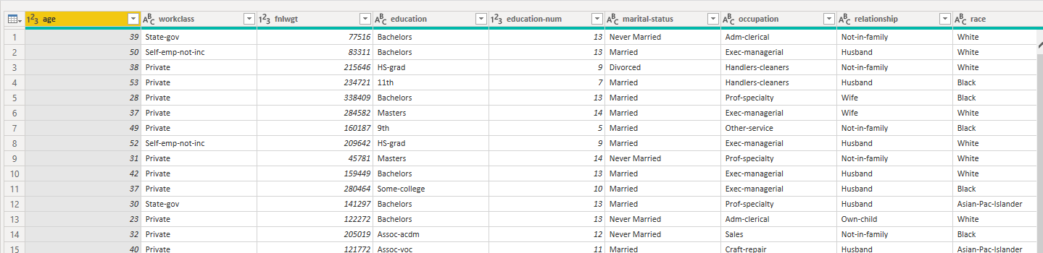
Set-up
Get data from CSV
Go to Transform data, add an Index column
Correct the data types and Remove NULL rows.

Slide 5
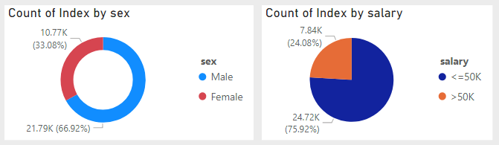
Assignment 1
Plot the 2 below shown visuals
Sex distribution by Index
Salary Distribution by Index

Slide 6
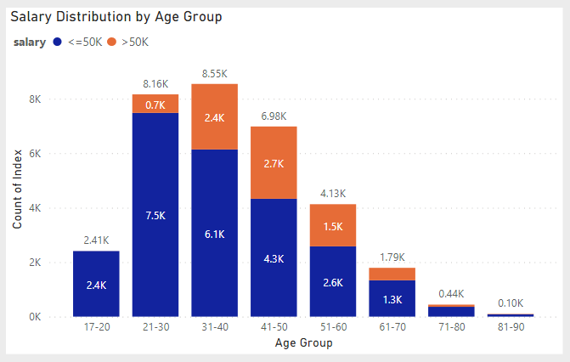
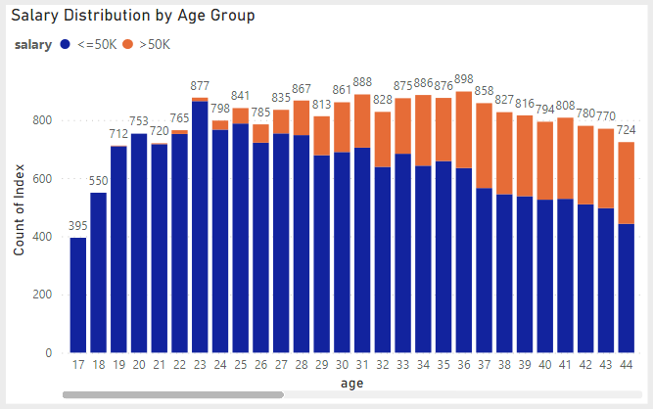
Assignment 2
The ages range from 17 to 90 years old with the majority of entries between the ages of 25 and 50 years
Plot a stacked column chart, showing the salary distribution per Age Groups.
Age Groups to be divided as follows
17-20
21-30
31-40
41-50
51-60
61-70
71-80
81-90
90+
Before
After

Slide 7
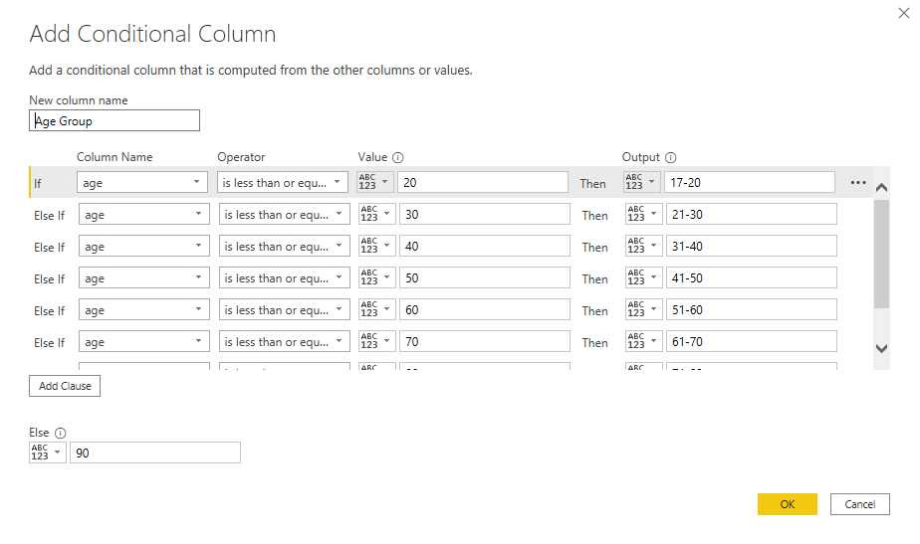
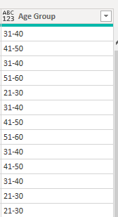
Solution 2
Step 1 - Add a Conditional column in power query as per the given Age Group condition
Step 2 - With help of Age group, Salary and index count plot the stacked column chart.

Slide 8
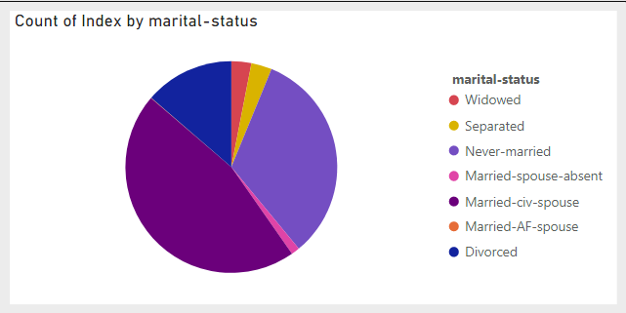
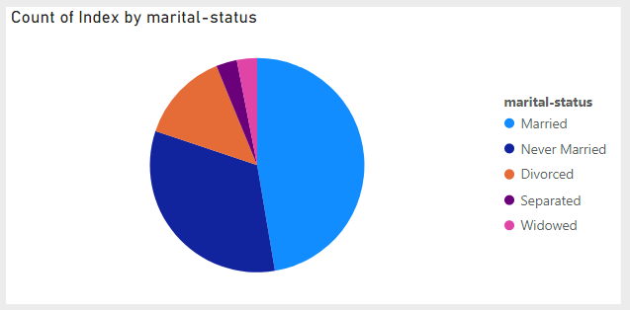
Assignment 3
Plot the 2 below shown visuals for the distribution of people by their marital status.
Married-­civ-­spouse
Married­-AF-­spouse
Married-­spouse-­absent
Divorced
Never­-married
Separated
Widowed
Club all the married ones under “Married”.

Slide 9
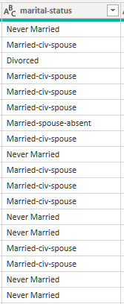
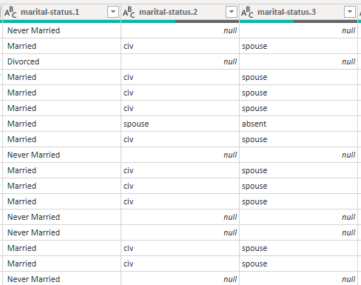
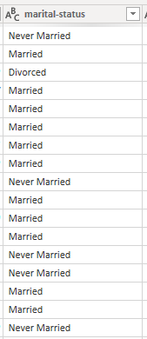
Solution 3
Step 1 - In Power Query, replace Never-married with Never Married.
Step 2 - Split column by delimiter “-”
Step 3 - Delete 2nd and 3rd columns of marital status, and rename the first as “Marital Status”
Step 4 - Now plot the same visual with this new column.

Slide 10
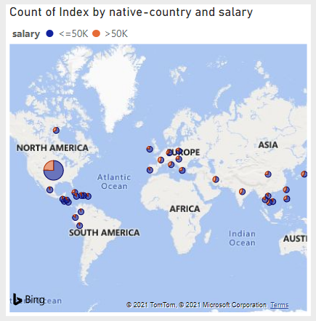
Assignment 4
Plot the below shown visuals for the distribution of people with salary per native country.

Slide 11
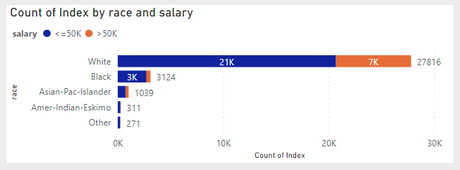
Assignment 5
Plot the below shown visuals for the distribution of Race with respect to salary.

Slide 12
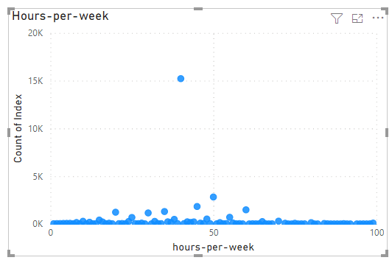
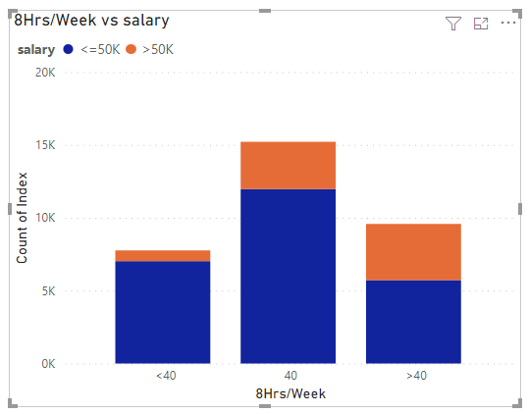
Assignment 6
Plot a scatter chart and a stacked column chart visuals for the Hours per week distribution with respect to salary.
Distribute as hours-per-week as below
<40
40
>40
Also distribute salary on stacked column chart visuals

Slide 13
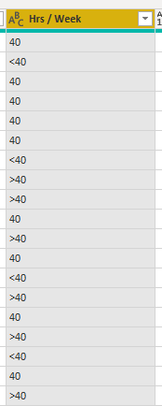
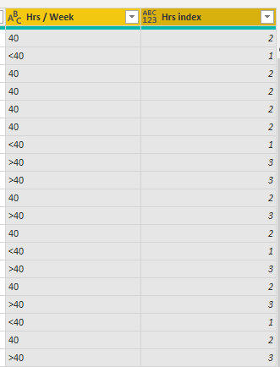
Solution 6
Step 1 - Add a Conditional column in power query as per the given “Hrs per week distribution”
Step 2 - Add another Conditional column to index the “Hrs per week distribution” column values.
Step 3 - plot the stacked column chart with this new column and sort the values using the conditional index created just now.
Step 4 - Distribute salary on stacked column chart visuals

Slide 14
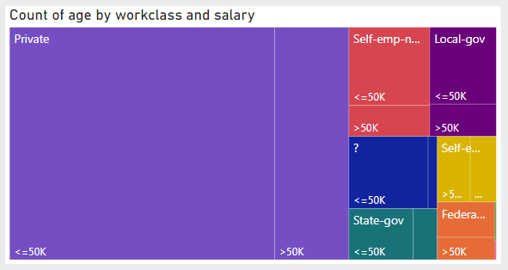
Assignment 7
Plot the Treemap visuals for workclass with respect to salary.

Slide 15
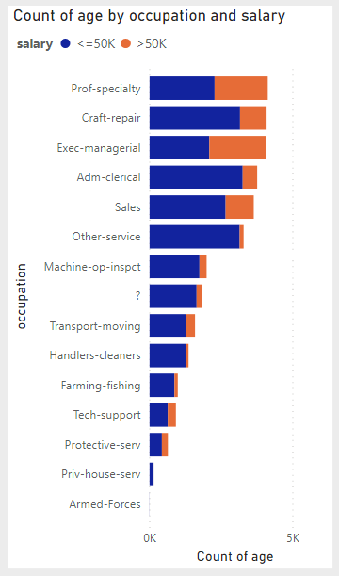
Assignment 8
Plot the visuals for Occupation with respect to salary.

Slide 16
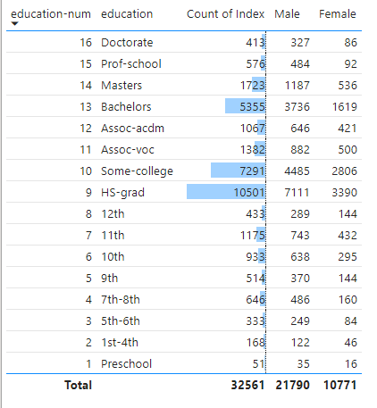
Assignment 9
Plot a Table visuals listing Education and count of people per category, aslo segregating male and female count in different columns.
Note- sort the table with education-num.

Slide 17
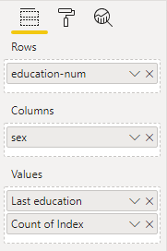
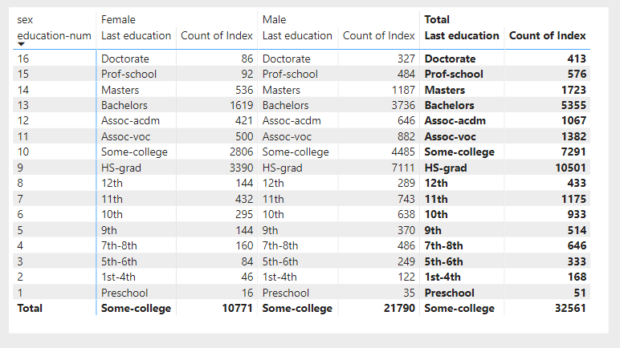
Solution 9A
Use the Matrix Visual and dop the relative columns as show in the below image

Slide 18
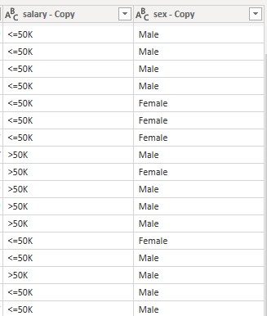
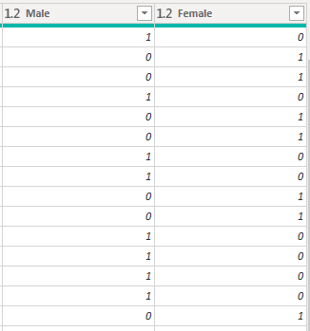
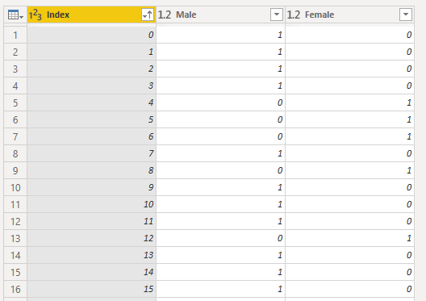
Solution 9B
Step 1 - Duplicate columns - Salary and sex
Step 2 - Then Select column Sex-copy and Povit Column using values column as salary-copy
Step 3 - Now you’ll see 2 separate columns as Male and Female with 0’s and 1’s
Step 4 - Set their data type as numbers.
Step 5 - Select Index, Male and Female then remove other columns.

Slide 19
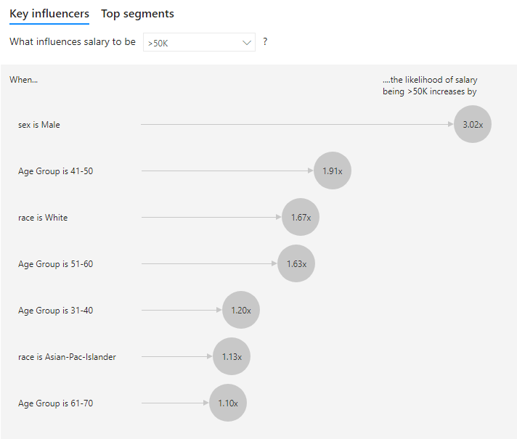
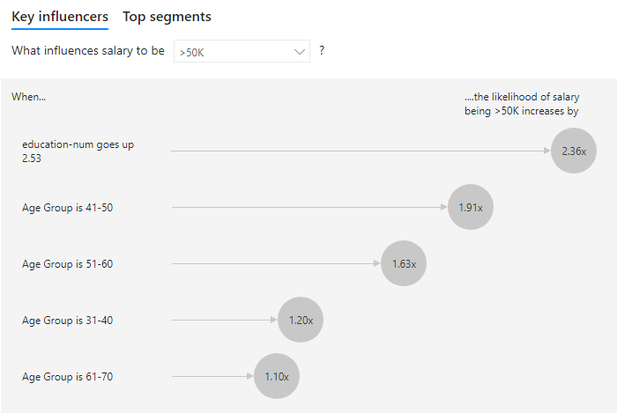
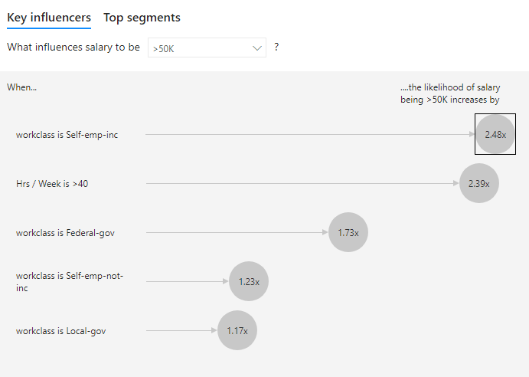
Assignment 10
Identify the columns used in this Key Influencers chart, any plot the same.

Slide 20
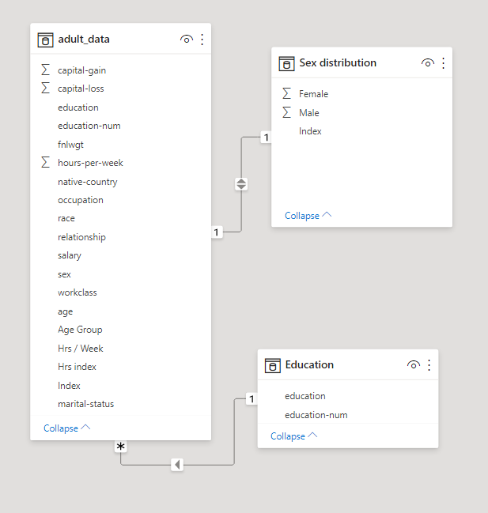
Relationships
Relationships Type
One-to-many (1:*)
Many-to-one (*:1)
One-to-one (1:1)
Many-to-many (*:*)
Cross filter options
Single
Both

